Slide 1


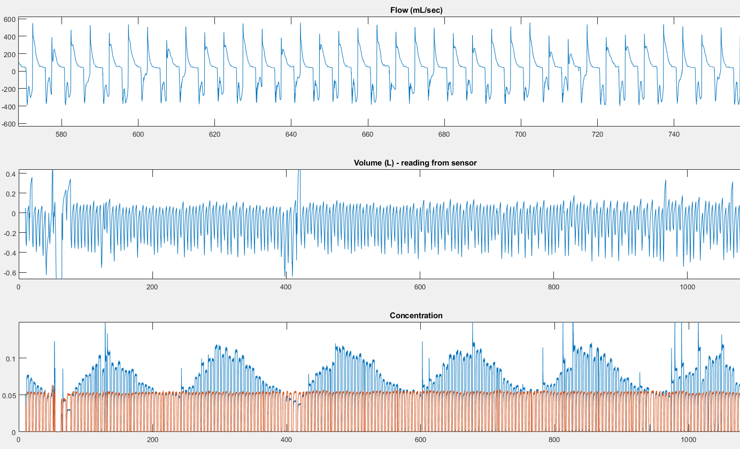
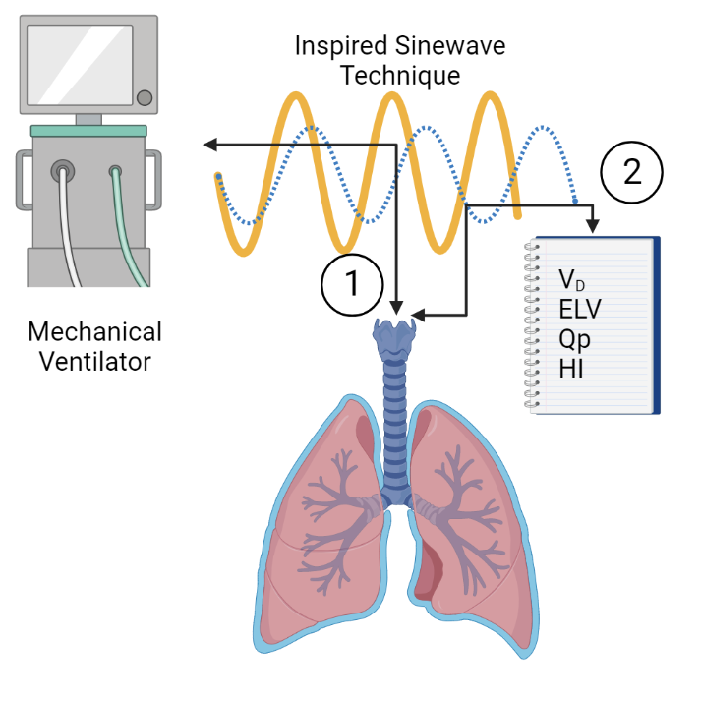
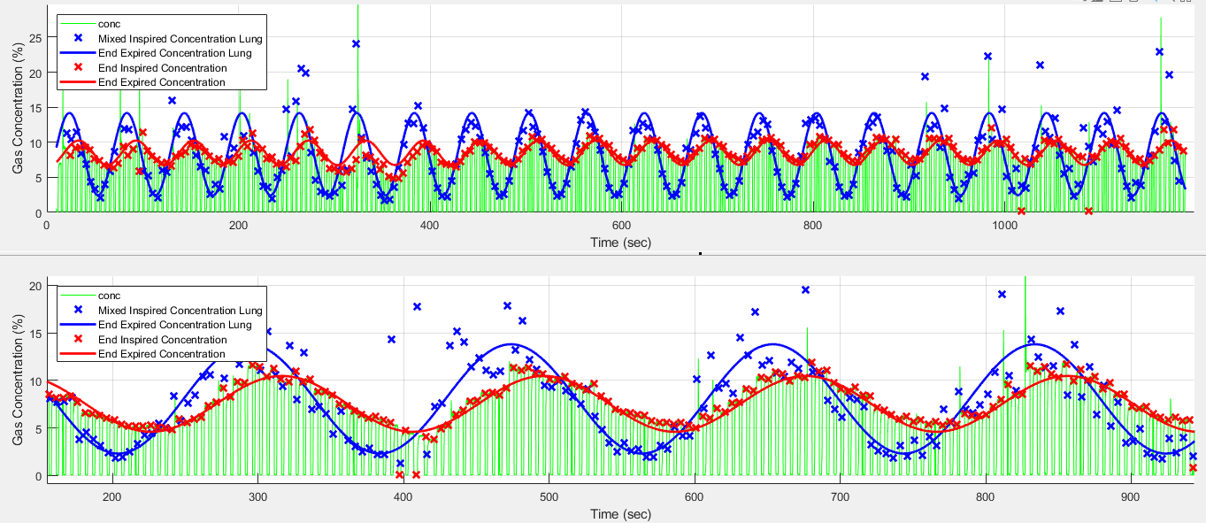



Measurement of Heart and Lung Function in Neurocritical care using the Inspired Sinewave Technique
Arun Joseph, Minh Tran, Douglas Crockett, Phi Phan, Andrew Farmery
^{University of Oxford}
Background
Patients with acute brain injury dependent on invasive mechanical ventilation may present with lung complications including ventilator associated pneumonia, acute lung injury and neurogenic pulmonary oedema
Measurement of crucial physiological parameters including dead space volume (V_{D}), effective lung volume (ELV), pulmonary blood flow (Q_{p}) and lung volume uncertainty index (HI) using inspired sinewave technique (IST) can help us understand complex brain-lung interactions and enable better ventilator management.
The IST is commercialized as InspiWaveTM by VentDx.
Methods
Results
Inspired sinewave technique involves feeding an oscillatory signal by adding small variable amounts of nitrous oxide in to the gas mixture to which the patient breathes.
The device was connected in series with the endotracheal tube in 10 intubated adult patients following primary brain injury for 60 minutes.
Comparison of the amplitude and phase of the inspired and expired signals provided measures of lung function.
Text
Raw data obtained when the IST sensor is connected in series with the endotracheal tube. Orange waveforms indicate CO2 (capnography) and the blue waveforms indicate the expired (N₂O) concentration
Green waveforms indicate end-tidal N₂O concentration, blue waveform with crosses indicates Inspired N₂O concentration and the red waveform and crosses indicates expired N₂O concentration (reduced amplitude) in 60 secs (top) and 180 sec s(bottom).
IST Output Values
Conclusion
IST Output Value | Mean | Standard Deviation
Dead space volume (mL) | 118 | 2
Effective lung volume (L) | 1.14 | 0.30
Pulmonary blood flow (L/min) | 10.6 | 4.1
Lung Volume Uncertainty index (%) | 73 | 38
This study confirmed the feasibility and safety of using the IST device in neurocritical care. No adverse events were recorded.
The IST successfully produced the cardiopulmonary measurements.
The measurement technique could be carried out in a busy clinical setting alongside other interventions for 60 minutes.
The IST data had sufficient precision (i.e signal: noise ratio) to enable analysis and measurement.
The data collection process was acceptable by patient’s families and clinicians and there were no concerns reported by families or clinicians.
Mean and standard deviation of IST output values
arun.joseph@jesus.ox.ac.uk

